Slide 1

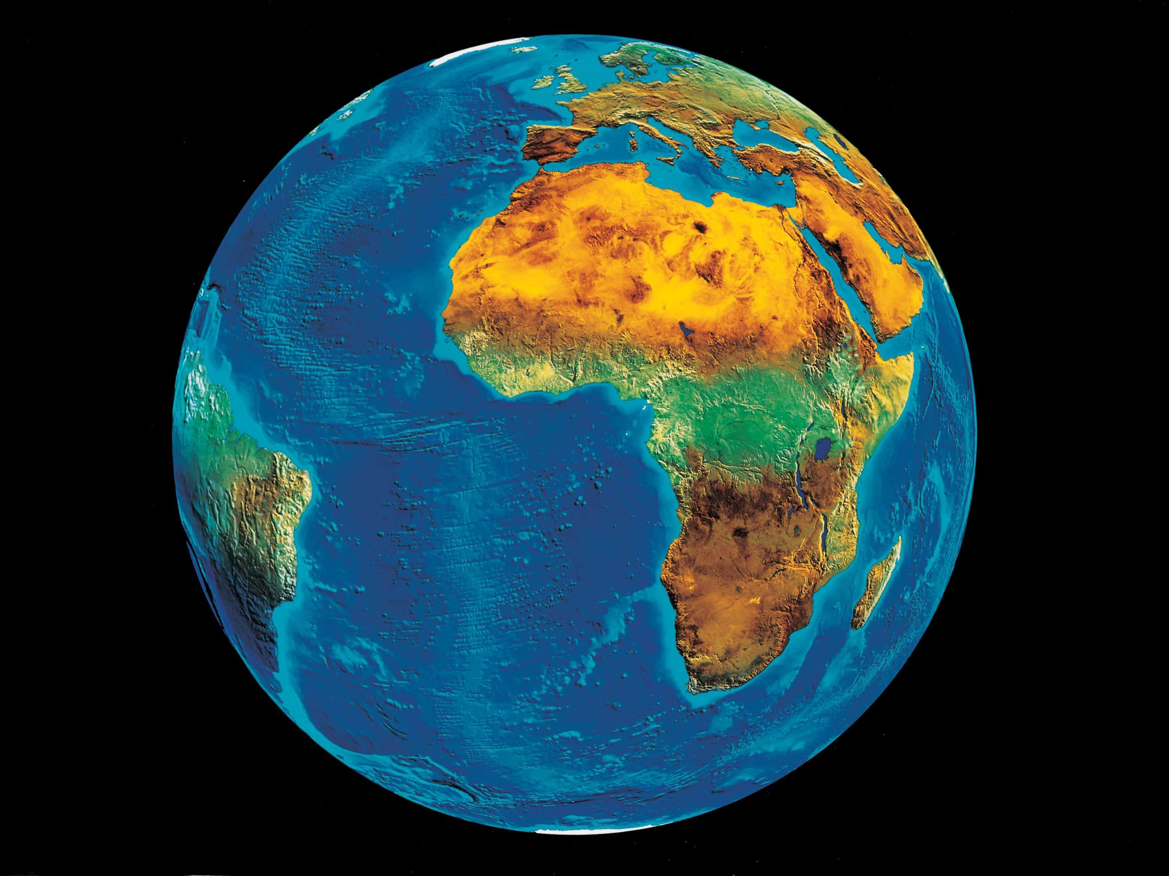
Earth Observation Applications Discovery
Notes:
Several platforms have emerged that provide access to Earth Observation data and processing capacities. These platforms host very large datasets, which makes a paradigm shift from data download and local processing towards application upload and processing close to the physical location of the data more and more important. To interpret peta- and exascale scientific data, capabilities of these platforms need to be combined in future.

Slide 2
Notes:
Testbed-13 and Testbed-14 Engineering Reports proposed solutions for packaging, deployment and execution of applications in cloud environments that expose standardized interfaces (OGC Web Processing Service (WPS)). The proposed approach was agnostic to the target cloud platform as long as a dedicated standardized interface such as an OGC WPS instance, a container execution environment (e.g. Docker), and data access are provided.

Slide 3

APPS
PROCESSES
CATALOGS
Notes:
T15 focus:
Apps & process discovery -> data model
Catalog interface for management and discovery
In order to for end-users to exploit such applications and already deployed processing capacities, facilities must be provided for users to discover the applications and to be provided with detailed descriptions and invocation instructions. This includes both applications to be deployed as well as already deployed applications that are available behind WPS interfaces.

Slide 4
Abstract & classification information
Data types and IO constraints
Quality information
Version and provenance
Interactive or non-interactive
Execution environment (e.g. Docker version, hardware requirements)
Execution end-points (e.g. URLs)
Metrics for costs estimation (data sizing, processing costs)
DATA MODEL
Notes:
2 essential components:
Data model,
Service interface for end-user
Service management interface

Slide 5
Search interface for discovery by facet and free-text in combination
Request interface for retrieval of facet dictionary to support browse
Request interface for retrieval of Application metadata
Management interface for the Creating, Update and Deletion of records in the catalogue
SERVICE
INTERFACE
Notes:
Service interface allows discovery of processing capacities and their management

Slide 6
Search interface for discovery by facet and free-text in combination
Request interface for retrieval of facet dictionary to support browse
Request interface for retrieval of application metadata
Management interface for the Creating, Update and Deletion of records in the catalogue
SERVICE
INTERFACE
Notes:
Service interface allows discovery of processing capacities and their management

Slide 7
OpenSearch extension for
EO Products & Collections
13-026r8
OWS Context GeoJSON Encoding Standard
14-055r2
OpenSearch Geo & Time extension
10-032r8
OpenSearch response encoding GeoJSON / JSON-LD
17-047
OASIS SRU &
OpenSearch Extension
Search and Retrieval via URL
Notes:
The bindings for the Catalogue and GeoJSON Data Model proposed in T15 are consistent with existing OGC Standards related to OWS Context and OGC Extensions of OpenSearch, namely [OGC 10-032r8], [OGC 13-026r9], [OGC14-055r2] and [OGC17-047]. Support for facet discovery and faceted search responses was borrowed from existing OASIS SRU specifications and the SRU extension of OpenSearch.

Slide 8
OWS Context GeoJSON Encoding Standard
14-055r2
OWS W*S
Operations
OGC API - *
Operations
DATA MODEL
dcat:DataService
Data Quality Vocabulary
GeoDCAT-AP
Notes:
The proposed Data Model relies on OGC OWS Context [OGC14-055r2].
Offerings describe service or application access mechanisms and endpoints. Additional offering types were needed to represent services based on a preliminary OGC API Common specification. These no longer have the concept of "operation" and applications accessible for deployment as Docker images.
In addition to the GeoJSON-based model, the corresponding JSON-LD representation has been explored. A service or application described in the catalog is modelled as a dcat:DataService in [DCAT-2]. This allows for quality related information to be associated using the Data Quality Vocabulary [DQV]. Where possible, the Data Model was aligned with [GeoDCAT-AP].

Slide 9
Transactions: OGC API Common
SERVICE
INTERFACE
Notes:
For the required transactional capabilities of the Catalogue interface, an OpenAPI Specification (formerly Swagger Specification, is an API description format for REST APIs) and the emerging OGC API Common specification was taken into account.

Slide 10
Notes:
Use Case A: "As owner of an application (still to be deployed or already deployed) or operator of a service, I shall be able to register my application in the Catalogue Service. I shall be able to update the metadata about the application stored in the Catalogue. Finally, at the end of life of the application, I shall be able to remove its metadata from the catalogue".

Slide 11
Notes:
Use Case B.1: "As owner of an application, I shall be able to deploy the application on a cloud platform, using for instance an Execution Management Service (EMS) as defined in Testbed-14. After the deployment, the cloud platform shall be able to register the application information in the Catalogue Service via a machine-to-machine interface".

Slide 12
Notes:
Use Case B.2: "As owner of an application, I shall be able to un-deploy the application from the cloud platform which shall therefore delete the metadata record relative to the application from the Catalogue Service via a machine-to-machine interface".

Slide 13
CLIENT
Notes:
Use Case C: "As a user of applications, I shall be able to use the Catalogue Service to find an application to perform a specific processing algorithm such as a normalized difference vegetation index (NDVI). I shall be able to fill a form with the available search criteria or uses a free text form to specify some keywords and then the Catalogue service shall return all the applications which match the specified criteria. The interaction between the user and the Catalogue Service shall be mediated by a client of the service which shall provide a GUI to ease the user experience".

Slide 14
CLIENT
Notes:
Use Case D: "As a user of applications, I shall be able to use the Catalogue Service to find first an application to perform a processing algorithm (e.g. classification) and then another application which can be fed with the output of the previous one (e.g. change detection) in order to create a complex application (a workflow or chain) to run systematically over a certain area of interest. The interaction between the user and the Catalogue Service or the cloud platform on the other shall be mediated by a client of the Catalogue service which provides a GUI to ease the user experience. The client shall support the user in verifying that the two applications are compatible (i.e. the input type of the second correspond to the output of the first) thanks to the information returned by the Catalogue Service".

Slide 15
Recommendations
Follow the recommendation made in the OGC API Hackathon Engineering report (OGC 19-062) to align the time and bbox related search parameters from the OGC OpenSearch Geo and Time Extensions (OGC 10-032r8) and the OGC API - Features - Part 1: Core standard
Additional work is needed to harmonize the link model and OpenSearch response metadata in GeoJSON (OGC 17-047) with the OGC API Features Standard.
This may require an update to OGC 14-055r2 (which defines a link model incompatible with OGC API Features) and the specifications that are based on the OGC 14-055r2 specification, including Earth Observation Product (OGC 17-003), Earth Observation Collection (OGC 17-084) and OpenSearch Response (OGC 17-047).

